Slide 1
Order Audit Trail System (OATS)
OATS Basics

Slide 2
Topics
OATS Overview, Rules and Reporting Obligations
Order Reports
OATS Data Processing
Order Lifecycle Creation
Firm Responsibilities
Resources

Slide 3
OATS Overview
What is OATS?
OATS is FINRA’s Order Audit Trail System. It is designed to capture all of the events in the lifecycle of an order from origination or receipt through execution and/or cancellation.
Why OATS?
OATS was developed by FINRA in response to the August 1996 settlement with the Securities and Exchange Commission (SEC). It is part of an integrated audit trail of order, trade and quote information used in FINRA’s surveillance activities.
FINRA role
To collect, process and provide feedback on a daily basis and to incorporate the data into the surveillance programs.
Firm role
To record and report data in an electronic format on a daily basis.

Slide 4
Rules
FINRA Rule 7410 - Definitions
FINRA Rule 7420 - Applicability
FINRA Rule 7430 - Synchronization of Business Clocks
FINRA Rule 7440 - Recording Order Information
FINRA Rule 7450 - Order Data Transmission Requirements
FINRA Rule 7460 - Violation of OATS Rules
FINRA Rule 7470 - Exemption from Recording

Slide 5
Overview of OATS
Current Scope:
All orders:
received by FINRA member firms,
in NMS and OTC listed equity securities,
whether received manually or electronically, are currently reportable to OATS.
Proprietary orders generated in the normal course of a firm’s market making activities are not reportable to OATS. All other proprietary orders are reportable.

Slide 6
Reporting Obligations
FINRA Rule 7440
Record data elements immediately following receipt or origination of an order
Express all times in hours, minutes and seconds (military time)
Record OATS information in electronic form
Retain information

Slide 7
Reporting Obligations
Third-party reporting
Written Agreement must be in place
Must coordinate submissions from multiple reporting parties
Make clear who is responsible for repairs
Supervise

Slide 8
Order Reports
Events
Receipt or Origination
Modification
Cancellation
Routing to another Desk
Execution
Routing to another firm
Report
New Order (NW)*#
Cancel / Replace (CR)
Cancel (CL) (can be added to NW or COR)
Desk (DS) (can be added to NW, OR, OE)
Execution (EX)*
Route (RT)#
*Also Combined Order / Execution (COE);
#Combined Order / Route (COR)

Slide 9
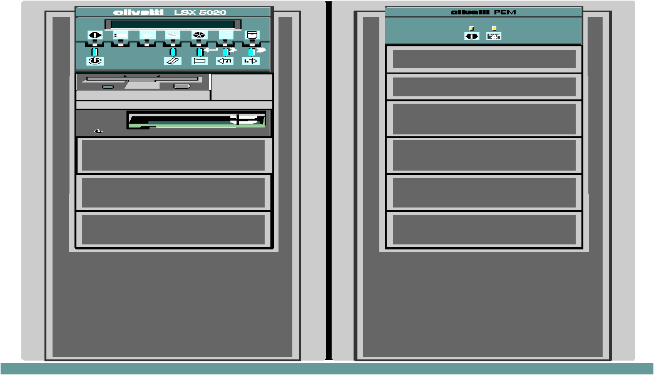
Overview of OATS Processing
Member Firm
Assembles
Records into
Files
Member Firm
Transmits
Files
Member Firm
Records
Order Events
FINRA Generates
Feedback and
Analyzes Data

Slide 10
OATS Data Processing
Data Receipt
Individual reports are packaged into files called FOREs (File of Order Reportable Events)
FOREs are transmitted on a daily basis via:
FTP (File Transfer Protocol)
IFT (Internet File Transfer)
Web submission
FORE Status (accepted / rejected) available within an hour via medium of submission or via the web
FORE Status is retained online for 90 calendar days

Slide 11
OATS Data Processing
Rejection Processing
Records from accepted files are sent to “Processor” to run through syntax and context validations.
Syntax validations - ensure records are submitted according to the OATS Technical Specifications (i.e., required fields are populated, symbols are valid etc…). Syntax rejections are available within 4 hours of submission.
Context validations - ensure records are submitted in proper context. A Route Report will reject if it is not linked to an accepted New Order. Context rejections are available within 24 hours of submission.
Rejections are available online for 90 calendar days

Slide 12
Order Lifecycle Within a Firm
Linking Reports Within a Firm
Use 3-part key: MPID (Market Participant Identifier), Order Received Date and Firm Order ID
Must be the same on each order event for the reports to link
Secondary reports (RT, CL, EX) are rejected if they can not match to a New Order type (NW, COR, CR)

Slide 13
OATS Data Processing
Matching
Data meeting validations then gets moved to “matcher” which matches
Orders to Trades (Order / Trade Matching)
Routes to NASDAQ and NYSE Exchanges (Exchange / Route Matching)
Routes to other firms New Orders (Interfirm Route Matching)
Unmatched statistics are available online for 90 calendar days
Unmatched details are available online for 90 calendar days

Slide 14
Order Lifecycle Creation: Matching
Interfirm Route Matching
Primary matching criteria:
MPID
Routed Order ID
Issue Symbol
Date
Order/Route Matching – Links Route Reports to Exchange Data
Primary Matching Criteria:
Exchange Participant ID
Routed Order ID
Date
Symbol

Slide 15
Order Lifecycle Creation: Matching
Order / Trade Matching - Links order executions to trades in the TRFs (Trade Reporting Facilities):
NASDAQ (FINRA / NASDAQ)
NYSE (FINRA / New York Stock Exchange)
ADF
OTC Trade Reporting Facility
Market Center ID must reflect proper trade reporting facility
Match on:
Branch / Sequence Number
Execution Timestamp
Issue Symbol
Firm MPID

Slide 16
Firm Responsibilities: Synchronize Business Clocks
Who? - Any FINRA member firms required under FINRA and/or NASDAQ Rules to record the date and time of any market event
What? - Synchronize clocks within three seconds of designated source, with to-the-second granularity
Where? - National Institute of Standards and Technology Atomic Clock
When? - Daily, prior to market open; check for drift throughout day and re-synchronize time as necessary
How? - Internet, software, radio waves

Slide 17
Firm Responsibilities: Submission Deadlines
OATS Business Day
Begins after the close of the NASDAQ Stock Exchange on one market day (16:00:01 ET)
Ends at the close of the NASDAQ Stock Exchange on the next market day (16:00:00 ET)
OATS Reporting Day
Events occurring during an OATS Business Day must be submitted to OATS by 08:00:00 ET the next calendar day or be considered late by FINRA
Please note: late validation looks at the time the individual record was submitted in relation to its event timestamp. OATS does not consider in late processing if the FORE was submitted timely.

Slide 18
Firm Responsibilities: ROE Reject Repair
Who? - Any Reporting Member, or member firm having data submitted on their behalf, to FINRA
What? - Any records rejected by OATS for syntax, semantic or context errors
Where? - https://firms.finra.org
When? - On a daily basis; rejects are available within 24 hours of processing; Syntax rejections available within 4 hours
How? - Through the Web Interface, FTP or IFT

Slide 19
Firm Responsibilities: Review of Web Site
Monitor the OATS Web Interface on a Daily Basis:
FORE Status Notification: Available within 1 hour of submission
Firm Reporting Statistics: Usually available within 24 hours of processing.
Rejections- Firms may view their rejections by: FORE, Summary, Rejection Type or in Group Symbol Repair
Order / Trade Match Statistics and Order / Route and Interfirm matching Statistics: Usually available for firms within 72 hours
View Announcements if no status available

Slide 20
Firm Responsibilities: Supervision
What should be included in OATS Written Supervisory Procedures:
Who is responsible for supervising OATS reporting?
How will they conduct reviews for OATS reporting?
When or how often will they conduct the supervisory reviews?
How will they evidence their supervisory reviews in writing?
Use Supervisory Logs
Members should refer to NASD Notice to Members 98-65, 99-45 and 02-29 as well as the OATS Reports on Supervision for additional guidance.

Slide 21
OATS Resources
The following resources are available to help members answer questions regarding OATS:
www.finra.org/oats
OATS Frequently Asked Questions
OATS Reporting Technical Specifications
OATS Subscriber Manual
OATS Report Index
OATS Registration Page
OATS for OTC Page
Report Cards
OATS Helpdesk 1-800-321-6273

